Slide 1
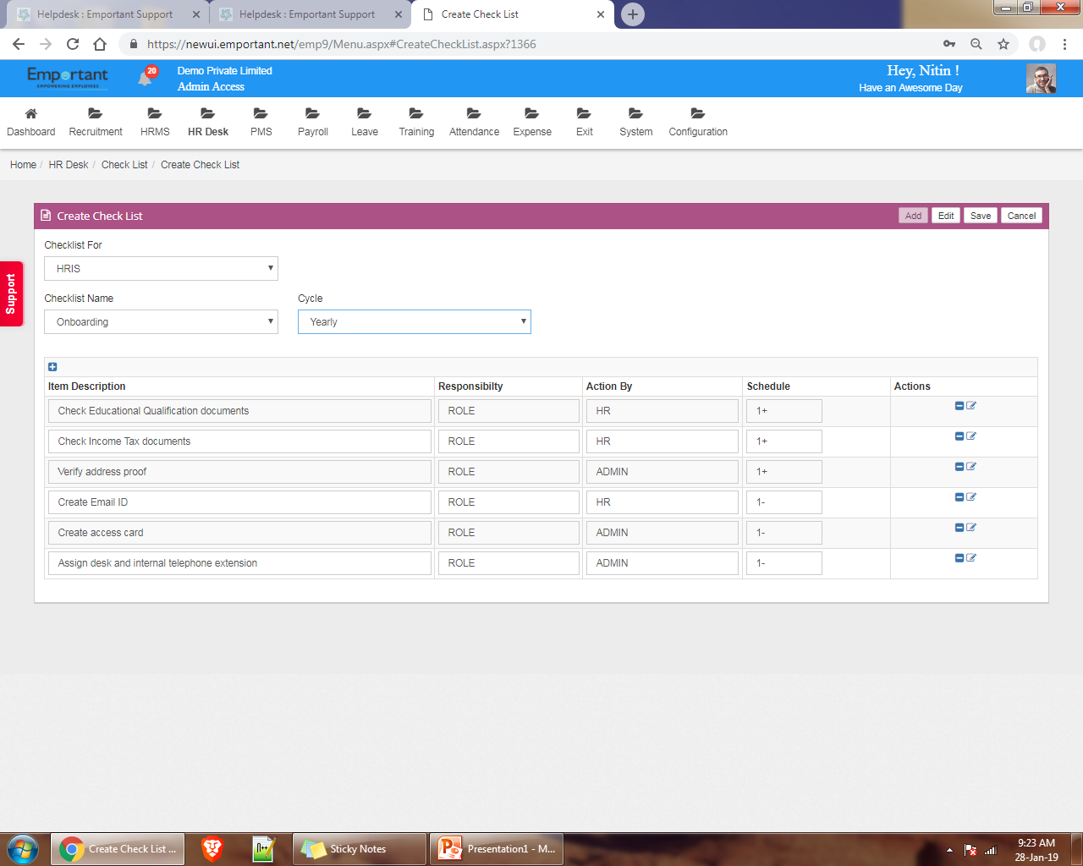
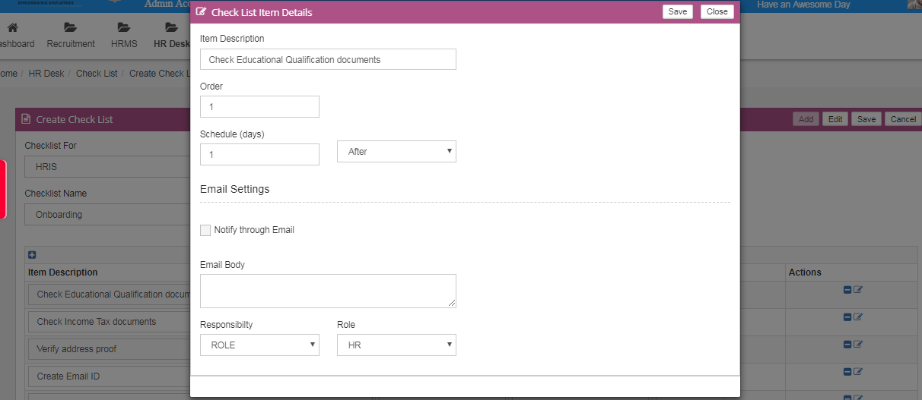
Click to Add new Checklist
Select module
Select cycle yearly or monthly /half yearly
Click to Edit to pop up window
Enter Description
Set schedule days to notify through email
Tick on checkbox to notify through email
You can put your contain
to send through email
Select role
Select responsibility

Slide 2
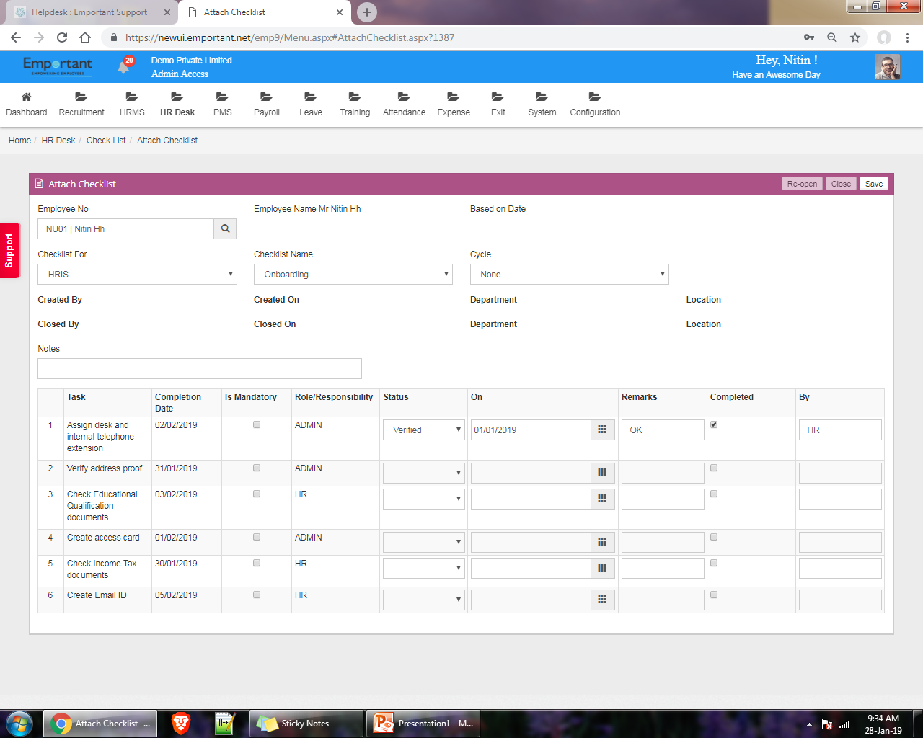
Click on save
Enter employee id
Select module
Select checklist name
Enter Notes
You can mark Is mandatory
Select status
Enter remarks

Slide 3
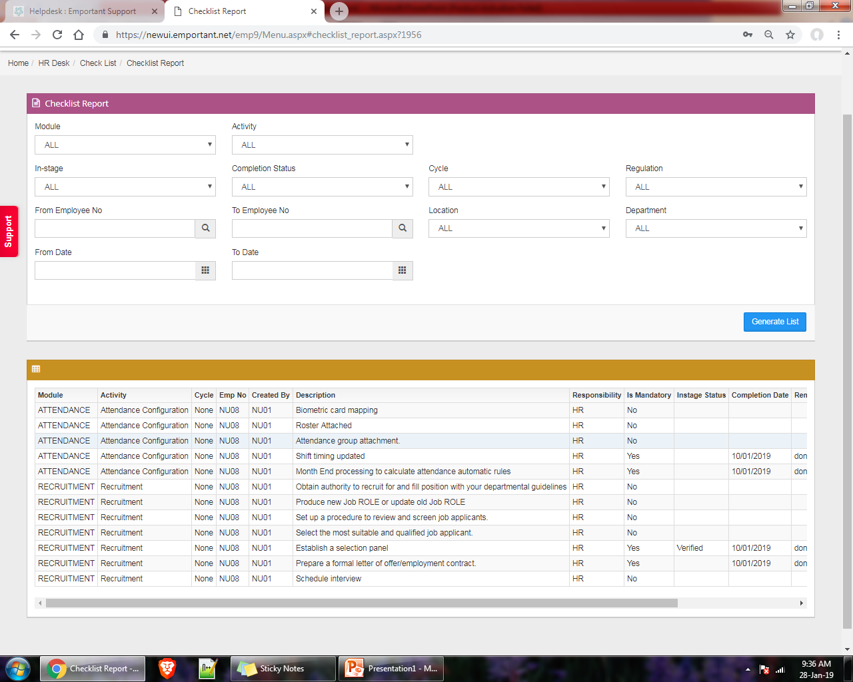
You can use filter to generate report
Click to generate list

